Slide 1
Plattsmouth Community Schools 2017-2018 Annual Report
www.pcsd.org
www.facebook.com/pcsd68048
https://twitter.com/PCSD68048_Supt

Slide 2
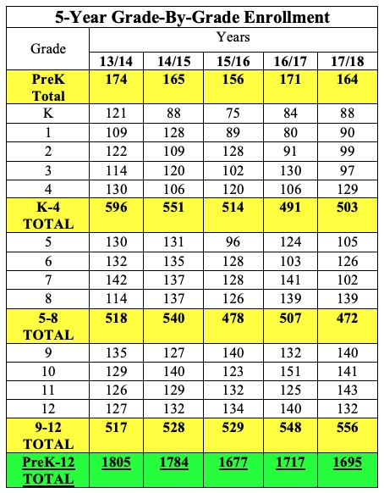

Slide 3
Free/Reduced Meals

Slide 4
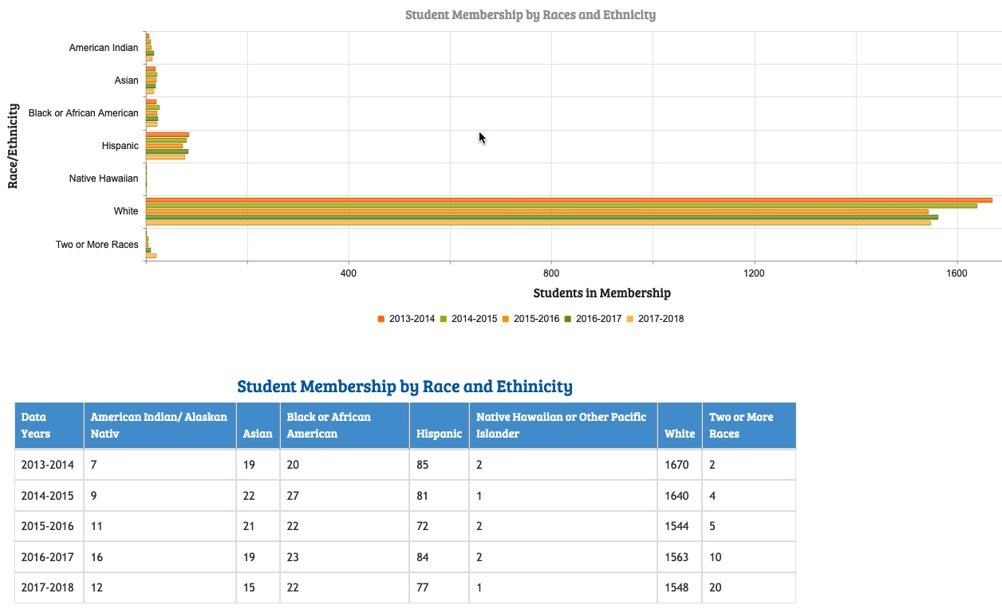

Slide 5
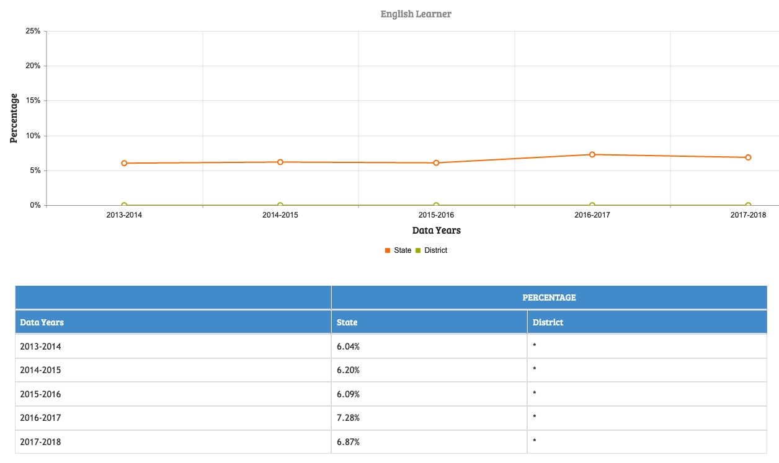

Slide 6
Average ACT Scores

Slide 7
Graduation Rates

Slide 8
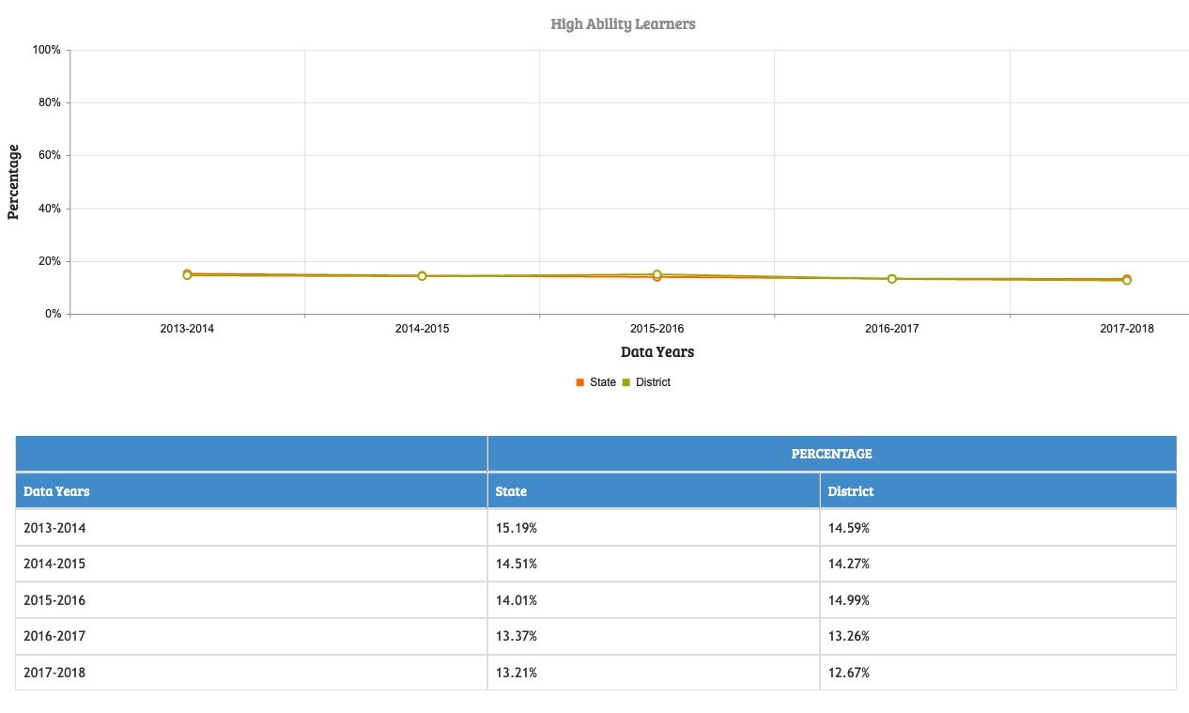

Slide 9
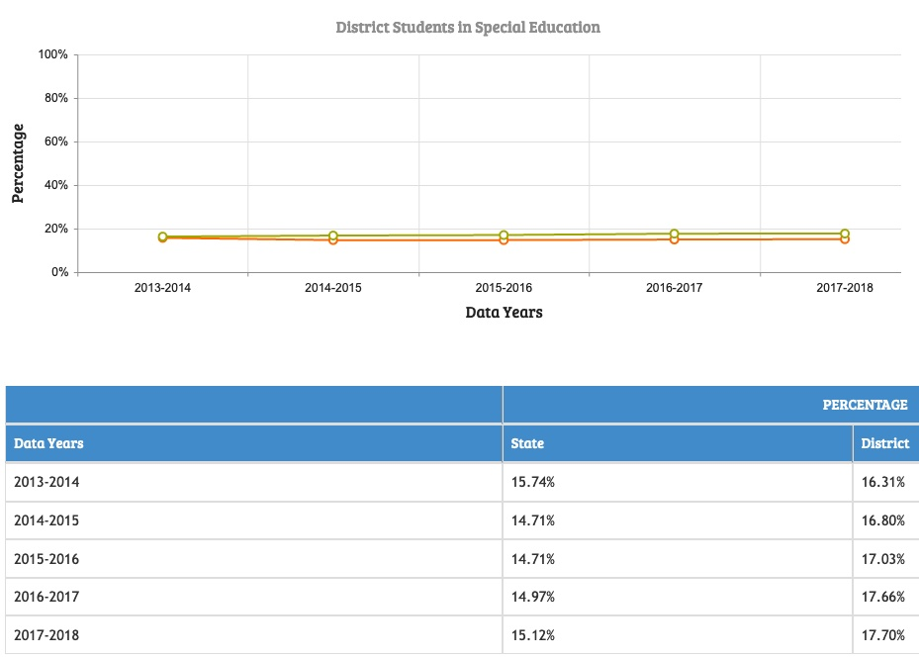

Slide 10
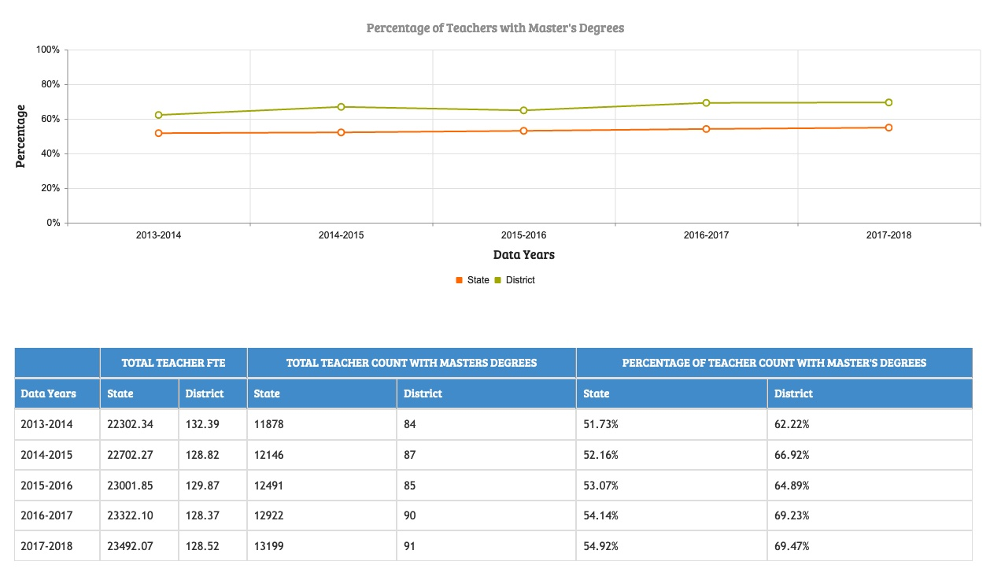

Slide 11
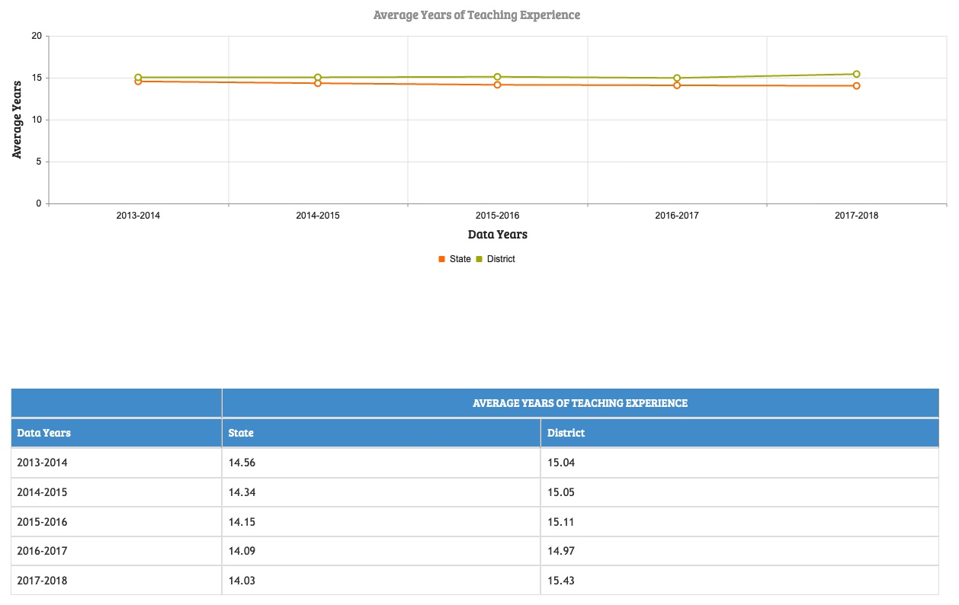

Slide 12
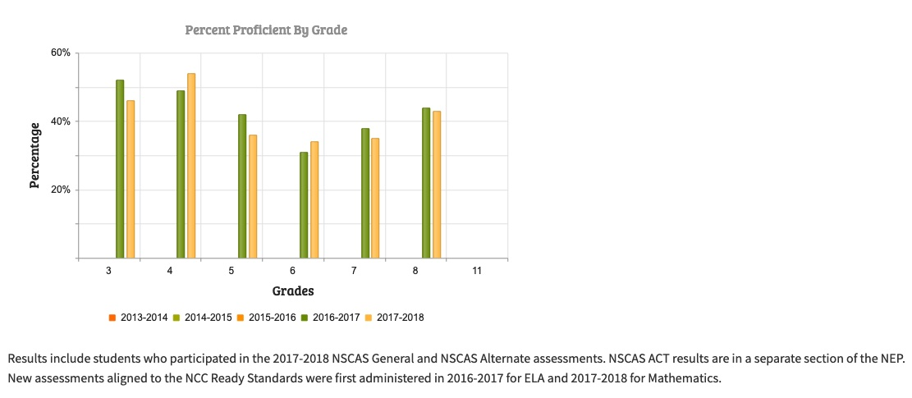
English Language Arts
NSCAS English Language Arts

Slide 13
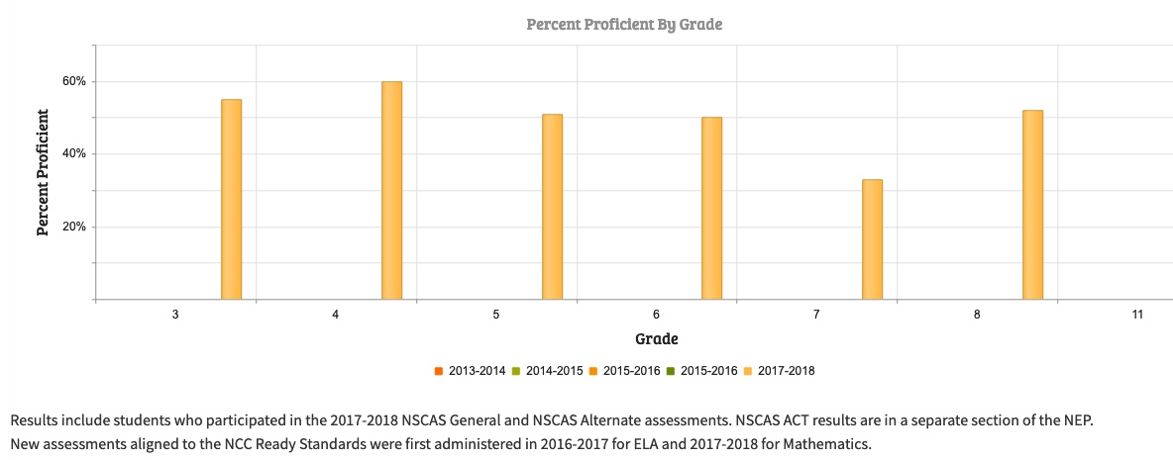
Mathematics

Slide 14
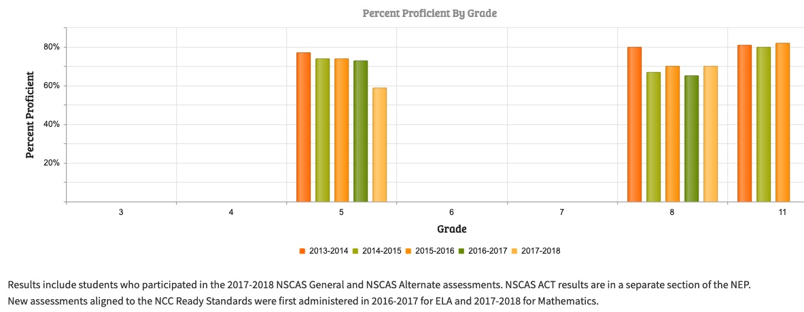
Science

Slide 18
Questions? Contact Supt. Dr. Richard E. Hasty rhasty@pcsd.org (402) 296-3361

